Slide 1
AutoML Evaluation
Abhishek Goyal and Mihika Jain
7th June, 2023.

Slide 2
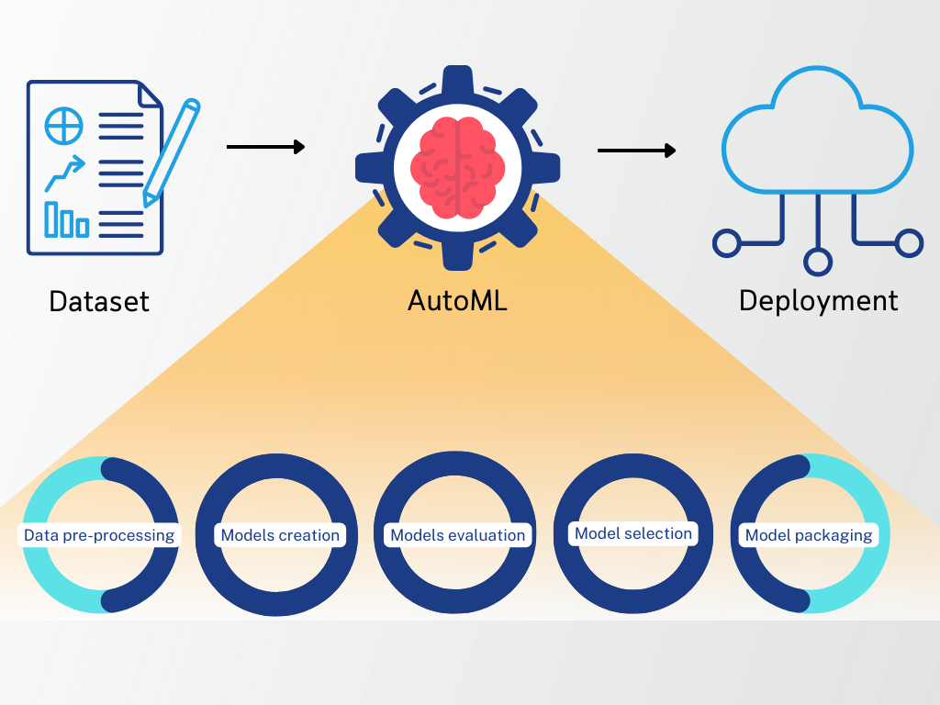
What is AutoML
AutoML => Automated Machine Learning
Automated machine learning is the process of automating the tasks of applying machine learning to real-world problems
Using AutoML, we could reduce the ML workflow by automating tasks like pre-processing, model building, model evaluation, hyperparameter optimization and model selection, model packaging

Slide 3
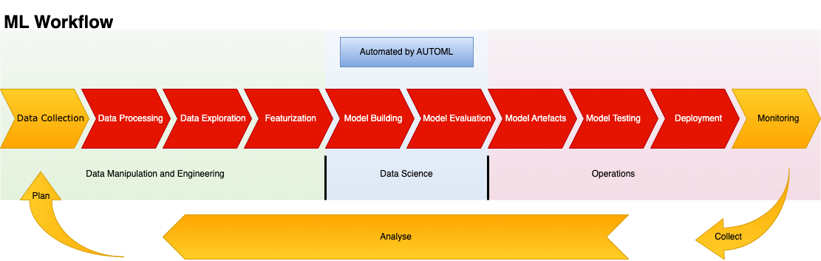
AutoML Tools Offerings
Explains the ML workflow and what part of it is automated by AutoML tools
Machine Learning Development Lifecycle
Notes:
Disclaimer:
1. All these tasks are not automated by AutoML tools.
2. Some of the tasks highlighted are out of the scope of certain tools.
3. Application integration is not part of the deployment process mentioned
4. For each tool, the level of automation is different

Slide 4


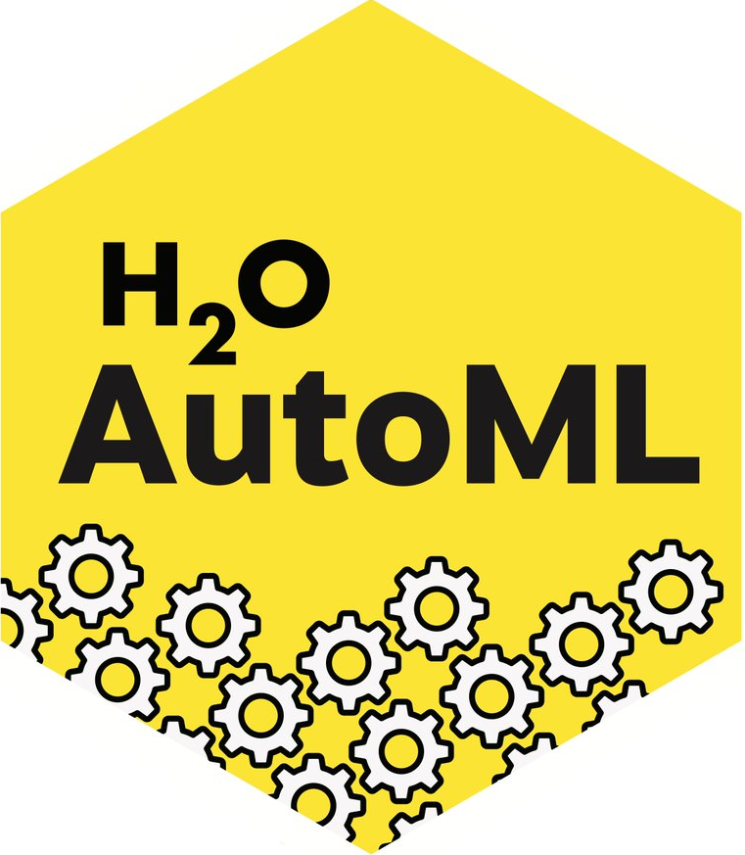

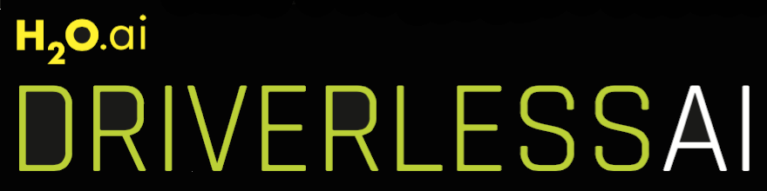


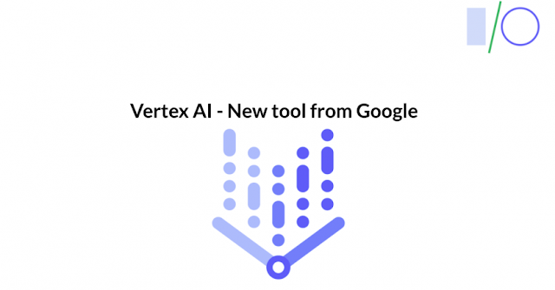


Why AutoML?
Aim: Automate the end-to-end process of applying ML workflow to real world problems
Key benefits:
Domain experts and business analysts can perform machine learning tasks
Data scientists can create and deploy more accurate models faster
Data Scientists can focus more on use case specific tasks like data wrangling, feature selection and fine-tuning rather than iterative tasks like algorithm selection, hyperparameter optimization etc.
Notes:
AutoML has use cases for both Business analysts, domain experts, and scientists, as well as Data scientists, who can leverage the simplicity and user-friendliness of AutoML. Since they are not Machine Learning experts and (This would lead to better adoptions in the company)
Enable Data Scientists can focus more on the non-iterative processes and domain specific tasks rather than focus more on the repetitive and monotonous tasks like finding and trying out algorithms
The user interface, automation of tasks and configurability of these tools helps users get work done more efficiently

Slide 5
Value Measure
Business value
Customer Value
Higher accuracy of results
Improved product quality
Faster turnaround time
Cost reduction
Faster MVP generation
Faster product upgrades
Increased ML adoption
Maintain competitive edge over market competitors
Saving resources
Notes:
Higher accuracy results: AutoML compares neural networks, and utilizes boosting techniques and ensembles to come up with better results.
Faster minimum viable product generation: Using AutoML, you can compare many different algorithms including ensembles, boosting algos and deep learning, in a duration of hours to days. The same level of comparison would take a manual approach weeks if not months. This makes MVP generation faster.
Increased ML adoption: The lack of ML knowledge among BU members and a lack of Data scientists prevents business units from adopting ML to achieve better results. Adoption of AutoML will not just help mend the bridge between domain and Machine learning experts, but also help teams with fewer to no data science experts and ML engineers adopt ML use cases
Saving resources: It is a huge reduction in resource utilization to use AutoML as it helps improve time efficiency, improves resource utilization, improves scalability and does not face issues of human error
Faster turnaround time
Cost reduction: By improving scaling. Resource utilization, time reduction and reducing the number of additional hires (data science experts), the cost to company is reduced

Slide 6
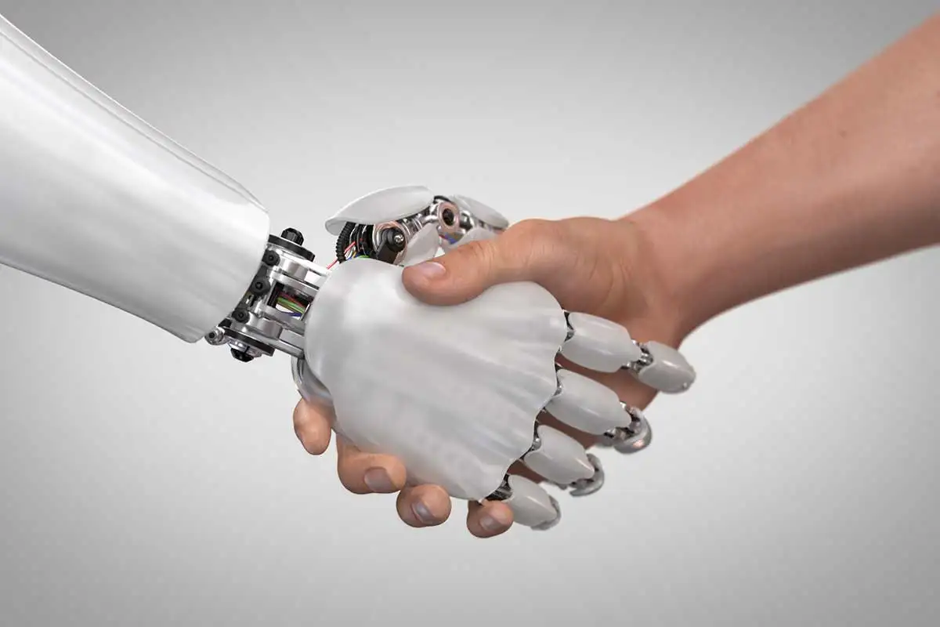
What AutoML isn’t
AutoML cannot understand domain and the context of the problem. It can only do the purely statistics-based pre-processing
Defining meaningful features, identifying relevant data sources and validating results is crucial manual work.
Application integration is not part of the deployment process of AutoML tools

Slide 7
AutoML Evaluations Initiative
Scope
Analyze the various available AutoML tools for different use cases
Success Criteria
Thermo Fisher business units leverage the benefits of standardized AutoML guidelines
Opportunities
Collaborate with roles to try AutoML tools with a business use case
Outcome
A comprehensive report for each tool analysed
A comparative study of all the tools

Slide 8
Functional & Non Functional Requirements
Functional Requirements
Non-Functional Requirements
Import data from various data sources
Handle different use cases
Handle different datatypes
Data cleaning
Pre-processing
Accurate model generation
Hyperparameter optimization
Leaderboard of rank ordered models
Support various evaluation metrics
Ease of use
Reproducibility
Performance
Data Security
Configurability
Usability
Transparency
Scalability

Slide 9
Tools being Evaluated
Tools to evaluate
AWS
Landing AI
Open source
Azure
H2O.ai
Databricks
Google cloud
UI based AutoML
CLI based AutoML
Canvas
Autopilot
Driverless AI
H2O-3 AutoML
Databricks AutoML
Vertex ai
LandingLens
Autogluon
Autokeras

Slide 10
Vendor Evaluations
Use Cases and Evaluation Criteria
Quality of service
Cost
Time-series Forecasting for the Data scientists in the Finance team
Image data processing for the Manufacturing department Quality checks
Supervised learning use cases on tabular data for predictions in many ThermoFisher Scientific products
Use case support
Evaluation
Criteria
Configurability
Level of AutoML-ness
Cloud platform support
Ease of deployment
Security
Usability
Scalability
Notes:
Definitions:
Level of AutoML-ness:

Slide 11
Current State
Research
H2O Driverless AI
Evaluation
AWS Canvas
Reporting
H2O AutoML
Azure Automated ML
Google Vertex AI
Databricks AutoML
AWS Autopilot
Autokeras
Autogluon
LandingLens
Notes:
Research: The tools which are being researched on the internet: Vendor documentation, blogs and other reliable sources are being used to understand the feature offerings. Mapping our requirements to the tool offerings?
Evaluation: Tools which are in the evaluation stage, wherein we test it out with our usecases
Reporting: Tools which are being documented by us, using our AutoML Evaluation Template

Slide 12

Feature Offerings
 | AWS Canvas | AWS Autopilot | Azure Automated ML | H2O Driverless AI | Databricks AutoML | Google Vertex AI
EDA
Pre-processing
Tabular prediction
Time series forecasting
Computer vision
Model selection
Hyperparameter optimization
Configurable
Transparency
Good documentation |  |  |  |  | cannot be | determined yet
* Note that these findings are purely based out vendor claimed offerings

Slide 13
Tech Radar for Tabular Data
Autokeras
Databricks AutoML
H2O AutoML
H2O Driverless AI
Azure AutoML
AWS Canvas
Autogluon
AWS Autopilot
Hold
Assess
Trial
Adopt
Notes:
The Tech-radar chart has technologies categorized based on where they stand in terms of 2 factors, represented by the quadrants and the rings. The quadrants represent different kinds of blips. The rings indicate what stage in the adoption lifecycle we think they should be in.
Basic definitions:
1. Blip: A blip is an AutoML tool or library that has been considered by us. Blips are ‘in motion’ and their position in the Radar is changing, indicating their current status
2. Hold: The Hold ring is for things that, even though they are accepted in the industry, we haven't had a good experience with
3. Assess: The Assess ring are things to look at closely, but not necessarily trial yet - unless you think they’re a good fit for you
4. Trial: The Trial ring is for blips that we think are ready for use, but not as completely proven as those in the Adopt ring
5. Adopt: The Adopt ring represents blips that we think you should seriously consider using

Slide 14
Tech Radar for Timeseries Data
Autogluon
AWS Canvas
Databricks AutoML
Autokeras
H2O Driverless AI
Azure AutoML
Hold
Assess
Trial
Adopt
Notes:
The Tech-radar chart has technologies categorized based on where they stand in terms of 2 factors, represented by the quadrants and the rings. The quadrants represent different kinds of blips. The rings indicate what stage in the adoption lifecycle we think they should be in.
Basic definitions:
1. Blip: A blip is an AutoML tool or library that has been considered by us. Blips are ‘in motion’ and their position in the Radar is changing, indicating their current status
2. Hold: The Hold ring is for things that, even though they are accepted in the industry, we haven't had a good experience with
3. Assess: The Assess ring are things to look at closely, but not necessarily trial yet - unless you think they’re a good fit for you
4. Trial: The Trial ring is for blips that we think are ready for use, but not as completely proven as those in the Adopt ring
5. Adopt: The Adopt ring represents blips that we think you should seriously consider using

Slide 15
Tech Radar for Image Data
Autokeras
AWS Canvas
H2O Driverless AI
Google Vertex AI
LandingLens
Hold
Assess
Trial
Adopt
Notes:
The Tech-radar chart has technologies categorized based on where they stand in terms of 2 factors, represented by the quadrants and the rings. The quadrants represent different kinds of blips. The rings indicate what stage in the adoption lifecycle we think they should be in.
Basic definitions:
1. Blip: A blip is an AutoML tool or library that has been considered by us. Blips are ‘in motion’ and their position in the Radar is changing, indicating their current status
2. Hold: The Hold ring is for things that, even though they are accepted in the industry, we haven't had a good experience with
3. Assess: The Assess ring are things to look at closely, but not necessarily trial yet - unless you think they’re a good fit for you
4. Trial: The Trial ring is for blips that we think are ready for use, but not as completely proven as those in the Adopt ring
5. Adopt: The Adopt ring represents blips that we think you should seriously consider using

Slide 16
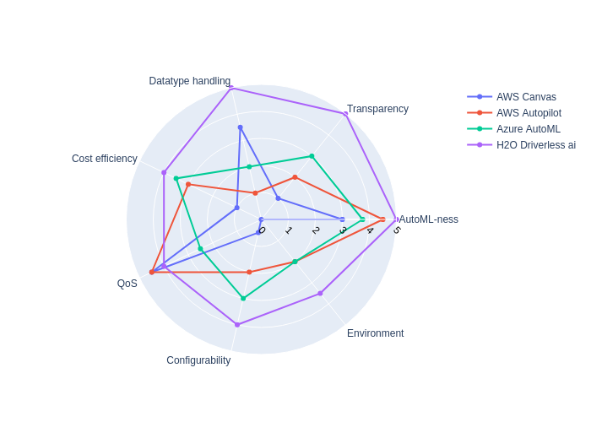
Vendor Evaluations
The Radar chart shows us a comparative study of the some of the Licensed tools
* Note that these findings are purely based out of the current state of research and these values will change on further evaluation
Notes:
The Spiderweb or “Radar chart” is used to rank some AutoML tool based on specific tool features.
Here, the licensed tools are ranked based off the following features:
Datatype handling: Which kinds of data can the tool ingest
Transparency: How much of the internal working of the model building process is exposed to us
AutoML-ness: How many steps in the ML pipeline can be done using the AutoML tool, without us having to do it beforehand or afterwards on the Jupyter Notebook
Environment: The cloud platforms etc. where one can deploy the generated model
QoS: Quality of Service. It is information about how efficiently the support team responds to errors and problems faced. How well are solutions provided to customers.
This is vendor agnostic
Vendor agnostic
Deployment agnostic
Cost efficiency: Lower the cost better is it for the tool measure, so the higher the rating.

Slide 17
Next Steps
Key actions moving forward
Onboarding a business point of contact to gain access to Thermo Fisher specific use cases with time-series, image and tabular data
Evaluate H2O Driverless AI with the real time business use cases
Get access to Google Vertex AI for evaluation
Get Databricks AutoML access and evaluate it
Review and publish the guidelines and evaluation results, and recommendations for AutoML tools
Have an immersion day with AWS to explore the new features of SageMaker Canvas
Priority 1
Priority 2
Priority 3
Priority 3
Priority 3
Priority 4
Notes:
List of immediate tasks to be finished ASAP, in that order, for us to move further

